Slide 1




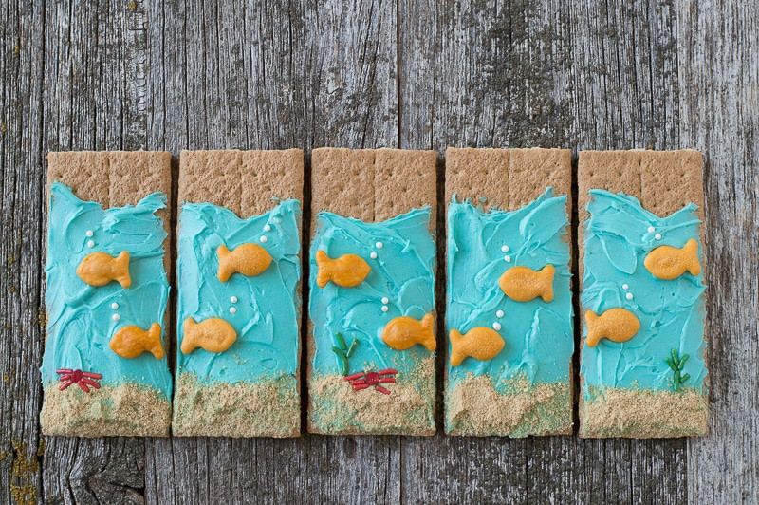
    Preschool Summer Program
    May 2026
Monday | Tuesday | Wednesday | Thursday | Friday
27 | 28 | 29 | 30 | 1
4 | 5 | 6 | 7 | 8
11 | 12 | 13 | 14 | 15
18 | 19 | 20 | 21 | 22
25 | WATER DAY TODDLERS 9:30-10 BEGINNERS 10-10:30 | 27 What’s Cooking Wednesday! Under the Sea Treats | 28 STEM CLUB | WATER DAY INTERMEDIATE 9:30-10 PPK 10-10:30 CAMP 1-1:30
Calendar is subject to change.
3180 Peachtree Parkway, Suwanee GA | 470 239 8373
Carrington Suwanee.com | Christinakraft@CarringtonAcademy.com

Slide 2


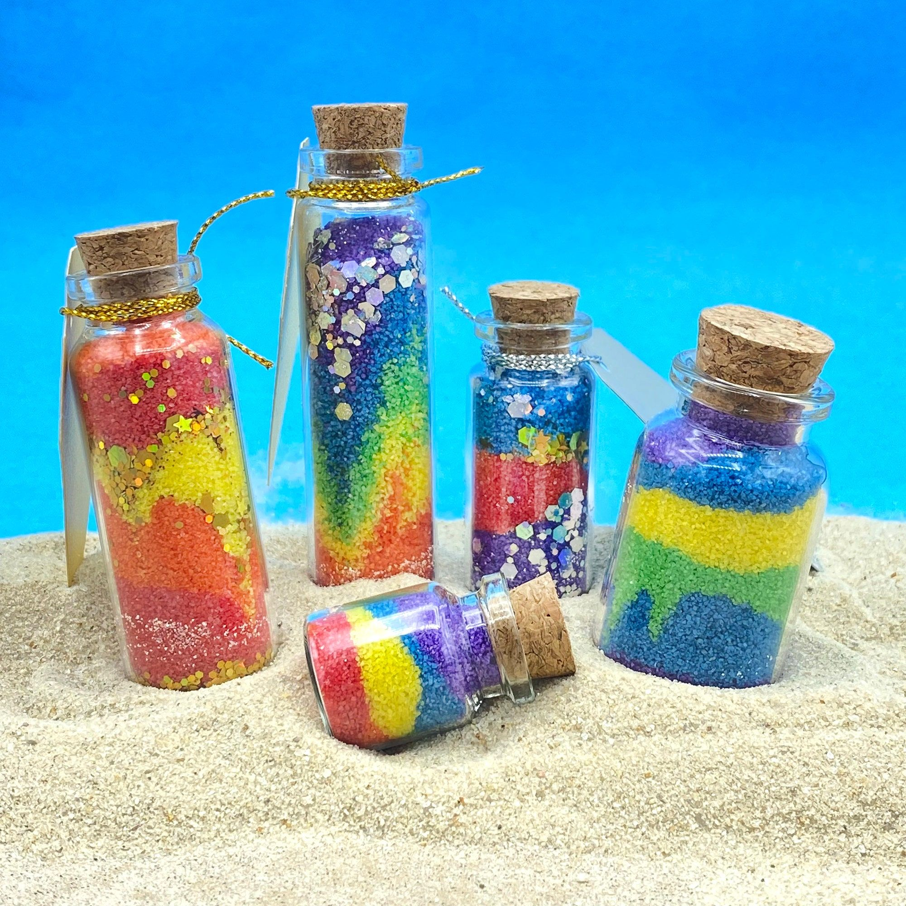






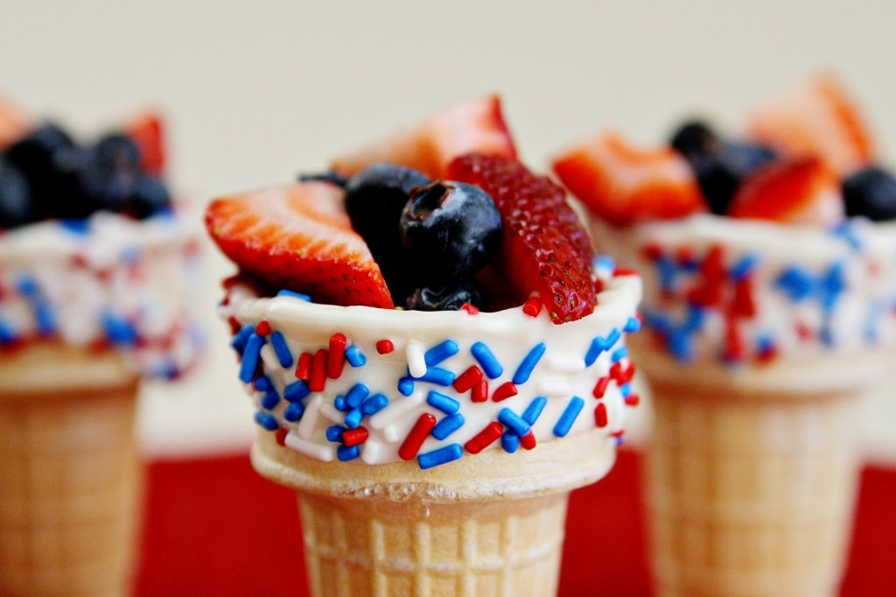






    Preschool Summer Program
    June 2026
Monday | Tuesday | Wednesday | Thursday | Friday
1. WATER DAY TODDLERS 9:30-10 BEGINNERS 10-10:30 | 2 DINOSAUR DAY | 3 CAMPING DAY | 4 SAND ART CREATIONS | 5 WATER DAY INTERMEDIATE 9:30-10 PPK 10-10:30 CAMP 1-1:30
8. WATER DAY TODDLERS 9:30-10 BEGINNERS 10-10:30 | 9 STEM CLUB | 10 | 11 HAWAIIAN DAY | 12 FATHERS DAY FIELD DAY
15 WATER DAY TODDLERS 9:30-10 BEGINNERS 10-10:30 | 16 Best Ice Cream On Wheels | 17What’s Cooking Wednesday Red White & Blue Fruit Cones | 18 UNDER THE SEA DAY | 19 Juneteenth No Camp
WATER DAY TODDLERS 9:30-10 BEGINNERS 10-10:30 | 23 NEON DAY | 24 PET SHOW DAY | 25 CHEETAH PRINT DAY | 26 WATER DAY INTERMEDIATE 9:30-10 PPK 10-10:30 CAMP 1-1:30
29 WATER DAY TODDLERS 9:30-10 BEGINNERS 10-10:30 | 30 STEM CLUB | 1 Decorate Bike or Trike Day! | 2 Americana Craft Day | 3
Calendar is subject to change.
3180 Peachtree Parkway, Suwanee GA | 470 239 8373
Carrington Suwanee.com | Christinakraft@CarringtonAcademy.com

Slide 3









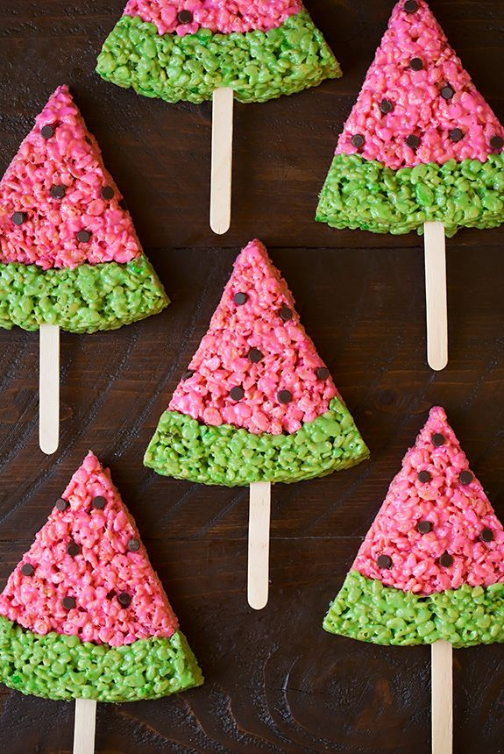
    Preschool Summer Program
    July 2026
Monday | Tuesday | Wednesday | Thursday | Friday
29 | 30 | 1 DECORATE A BIKE OR TRIKE! | 2 AMERICANA CRAFT DAY | 3 July 4th Holiday No Camp
6. WATER DAY TODDLERS 9:30-10 BEGINNERS 10-10:30 | 7 CRAZY HAT DAY | 8 WINTER IN JULY DAY | 9 NATIONAL SUGAR COOKIE DAY | 10 WATER DAY INTERMEDIATE 9:30-10 PPK 10-10:30 CAMP 1-1:30
13 WATER DAY TODDLERS 9:30-10 BEGINNERS 10-10:30 | 14 Best Ice Cream on Wheels | 15 | 16 GLOW PARTY | 17 FAIRY TALE BALL DAY!
20 WATER DAY TODDLERS 9:30-10 BEGINNERS 10-10:30 | 21 STEM CLUB | 22 BUBBLE DAY | 23 CHALK DAY | 24 WATER DAY INTERMEDIATE 9:30-10 PPK 10-10:30 CAMP 1-1:30
27 WATER DAY TODDLERS 9:30-10 BEGINNERS 10-10:30 | 28 PAJAMA DAY | 29 Whats Cooking Wednesday | 30 BACK TO SCHOOL PARTY | 31 WATER DAY INTERMEDIATE 9:30-10 PPK 10-10:30 CAMP 1-1:30
Calendar is subject to change.
3180 Peachtree Parkway, Suwanee GA | 470 239 8373
Carrington Suwanee.com | Christinakraft@CarringtonAcademy.com

Slide 4






    Preschool Summer Program
    August 2026
Monday | Tuesday | Wednesday | Thursday | Friday
3 | 4 | 5 | 6 | 7
10 | 11 | 12 | 13 | 14
17 | 18 | 19 | 20 | 21
24 | 25 | 26 | 27 | 28
31 | 1 | 2 | 3 | 4
Activity Blocks
Use activity block logos to represent the activity on the calendar.
Calendar is subject to change.
3180 Peachtree Parkway, Suwanee GA | 470 239 8373
Carrington Suwanee.com | Christinakraft@CarringtonAcademy.com

